Slide 1
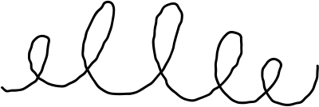




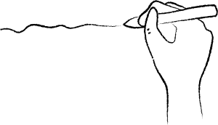







Navigating the Nuances of Sarcasm Detection
SARCASM
Trimming the Verbose
Towards Greener
NLP
A Data-Efficiernt Approach

Slide 2







By Siam Sadman
Azad
20141002
1
A captivating area of NLP research
Introduction
Deciphering ironic intent in texts
2
Exploring data pruning and loss function optimization for enhanced sarcasm detection performance
Datasets; iSarcasm(tweets) & SARC
(Reddit)
3
Challenges in Achieving State-of-the-Art Performance
4

Slide 3







Dataset Selection
Action 1
Action 3
the RoBERTa based sarcasm detection model proposed in Abaskohi
the Sarcasm Headlines Dataset(Misra&Arora)
iSarcasm, a collection of tweets
1
Action 2
Action 4
SARC, a repository of comments from Reddit posts
iSarcasm dataset with the sentiment140 dataset
2
the iSarcasm Dataset (Opera&Magdy)
Copy a sticky note, then write your thoughts

Slide 4






Data Pruning Technique
select a subset of Data while preserving nuances
Expedite training process and alleviate computational strain
1
3
reduce training set size and computational demands
significantly reducing overall training set size
2
4

Slide 5




Loss Function Exploration
Copy a sticky note, then write your thoughts
Copy a sticky note, then write your thoughts
This section can contain background information to give your team greater context on the problem you're trying to solve.
What is the problem?
How do we know this
is a problem?
How will we know when we've solved this problem?
Data Quality issue
Data Imbalance
Noise
Bias
Lack of representativeness
recognizing the potential impact of dataset quality on model performance
This work demonstrates that dataset pruning can effectively reduce the size of training data while maintaining comparable performance to models trained on larger datasets

Slide 6








Motivation & Benefits of Pruning
Reduce training time for
hyperparameter optimization
1
Conserve energy and minimize resource utilization
2
Enhance model robustness for noisy datasets
HOW ARE YOU FEELING?
3
Our motivation for data pruning stems from its multifaced benefits

Slide 7





Future
Direction
Bridge the gap between data efficiency and performances
1
Integrate data-efficient sarcasm detection algorithms into real-world application
2
I am excited to share our findings and engage in a meaningful discussion with all of you
Enhance accessibility and applicability of sarcasm detection
3

Slide 8










Thank you for
your time!
I’d love for my Peers to share their expertise & experiences

Slide 9
Related Work
the best
loading...
who is doing all this???

Slide 10
My findings
1
Models and Dataset
3
Test errors
2
Benchmark
4
Different loss functions

Slide 11


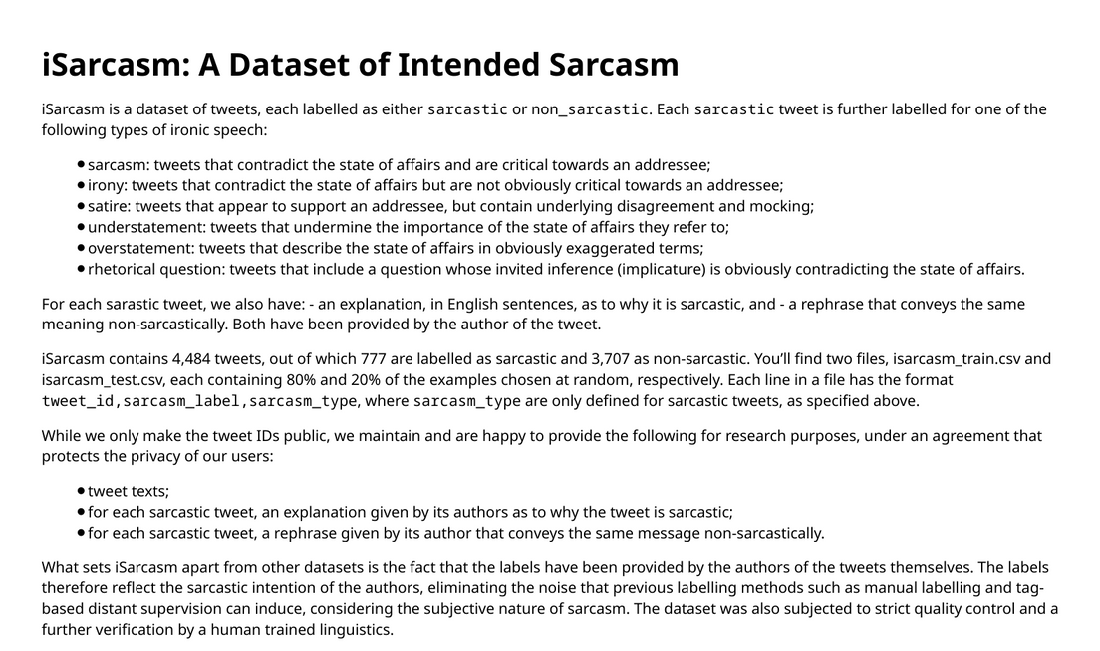


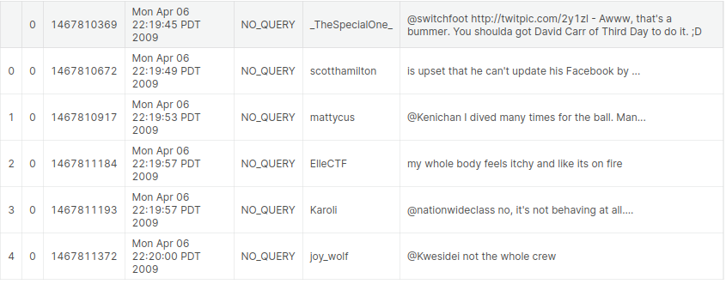



Models and Datasets!
We looked at RoBERTa based sarcasm detection model proposed in Abaskohi et al.[2022]. In an effort to increase the size of the train set, they also try to augment the iSarcasm dataset with the Sentiment140 dataset (Go et al. [2009]) and the Sarcasm Headlines Dataset(Misra and Arora [2019]). The Self Annotated Reddit Corpus (Khodak et al. [2017]) is a also another dataset of Reddit comments labeled for perceived sarcasm. They label comments using distant supervision.
iSarcasm
Sentiment140

Slide 12
Benchmark
The authors find that RoBERTa, fine tuned for sentiment classification, without any data augmentation and further fine tuned only on the iSarcasm dataset gives them the best performance, a F1 score of 0.414. This model falls short of the same RoBERTa model fine tuned for sarcasm detection by Hercog et al. [2022], using a training set comprising iSarcasm and a subset of SARC to obtain a F1 score of 0.526 on iSarcasm.
0.414
0.526

Slide 13


Test errors!
Test errors are mistakes made by a model when making predictions on unseen data. They are typically measured using metrics such as accuracy, precision, recall, and F1 score. Test errors are important because they reflect the real-world performance of a model. A model with high test errors is not likely to be useful in practice.
In Sorscher et al. [2022], the authors look for ways to select training samples such that the reduction in test error does better than the scaling laws, described in Kaplan et al. [2020] and Hoffmann et al. [2022], which tell us to expect power law scaling - a drop in error from 3% to 2% may need an order of magnitude more data.

Slide 14
Different Loss functions!
Abaskohi et al. [2022] use the Cross Entropy Loss. To address the class imbalance in the iSarcasm dataset, a natural thought would be to use Weighted Cross Entropy Loss.One of the drawbacks of this approach is that by up-weighting the minority class, there is a risk that the number of false positives may increase. Squared Hinge Loss has been shown to perform well in classification tasks (Lee et al. [2015]).
In machine learning, a loss function is a mathematical function that measures the difference between the predicted output of a model and the desired output. It is a crucial component of the training process, as it guides the model towards learning better parameters. Different loss functions are suitable for different types of tasks and datasets.

Slide 15



Future Plan for sarcasm detection using nlp
Future Plan
Improve the detection of sarcasm in multimodal contexts
1
what can be done by finetuning
of sarcasm detection?
Address the challenge of cross-cultural sarcasm detection
2
Handle sarcasm in real-time applications
3
Tailored training Algorithms
Sensitive Evaluation Matrices
Expand the scope of sarcasm detection applications
4
Enhance the interpretability of sarcasm detection models
5

Slide 16

Conclusion
In this work, by applying dataset pruning it, we hope to achieve performance comparable to models trained on much larger training data. By ordering misclassified samples by classification confidence (logit scores), we arrive at a difficulty ordering of the data, which makes it possible to apply curriculum learning (Bengio et al. [2009]) to our task, which could give further performance improvements and is left as future work.

